Slide 1



Integrating Defenders & Attackers into Cyber Security Risk Models
Varun Agarwal
Diane Henshel, Alexander Alexeev, Mariana Cains

Slide 2
Outline
Motivation & Research Goals
Technical Approach & Conceptual Framework
Statistical Application
Preliminary Results
Conclusions & Future Work

Slide 3
Motivation & Research Goals
Current cyber security risk modeling frameworks include only hardware and software
Importance of human factors is under-represented in major risk assessment frameworks
So, we propose a model
The goal is to:
Incorporate human factors (attackers & defenders) in cyber risk models
Model risk dynamically
Identify minimum number of necessary and sufficient variables that capture the dynamic system risk
Finally, evaluate cause of high-risk situations

Slide 4
Technical Approach
To achieve our goal
We use hybrid Bayesian network to build our risk model
Reason - Bayesian networks allow for causal inference
Graphical models are more suitable for assessing risk in complex systems
Presented model is built around modeling risk to a database server

Slide 5
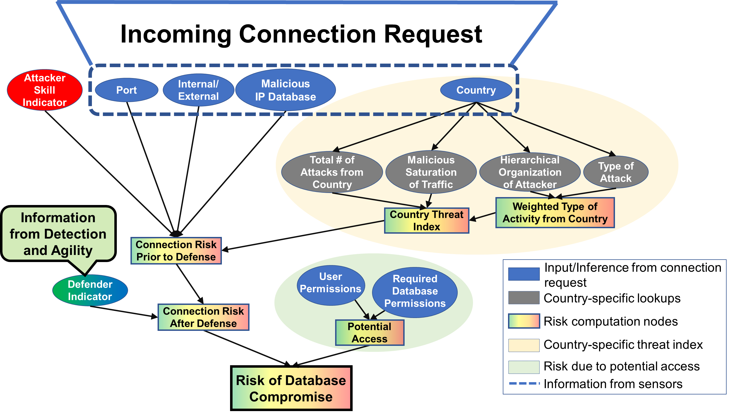
Conceptual Risk Framework
Framework outputs risk associated with an Incoming Connection Request

Slide 6

Step 1 - Incoming connection request detected
Notes:
The network in question detects an incoming connection request.

Slide 7
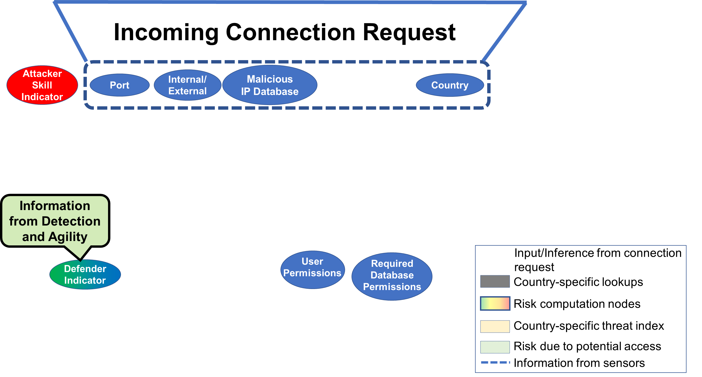
Step 2 - Set evidence for inferences from connection request
Notes:
The network in question detects an incoming connection request.

Slide 8
Attacker Skill – Distribution informed by prior experience
Notes:
Attacker Skill Indicator, which is one of the human factors that we include in our model, is measured by attacker frequency. Attacker frequency is calculated by the number of connection requests received from a particular source IP Address. If the database server receives high number of requests from a single IP, then the attacker sending those requests is probably a lower skilled attacker. On the other hand, if the attacker frequency is low, it might be representative of a higher skilled attacker, as we would suspect in the likes of an APT attack.

Slide 9
Port – port through which connection request comes in (e.g. Port 80 for HTTP, Port 22 for SSH)
Notes:
The metric “Port” identifies what port is being used for the connection to the database server. It accounts for the fact that some ports are riskier than other ports.

Slide 10
Internal/External – Is origin of connection Request internal to server’s network?
Notes:
The Internal/External metric is a categorical variable

Slide 11
Malicious IP Database – Is IP listed in online malicious IP databases?

Slide 12
Defender Skill – Can be measured through internal assessments of cyber security experts/defenders (Low skill, Medium skill, High skill)

Slide 13
User Permission – Access level that the user possesses (Low, medium, high)

Slide 14
Required Permission – Access Level required to communicate with server

Slide 15
Country – Geographical origin of the connection request, as identified by IP

Slide 16
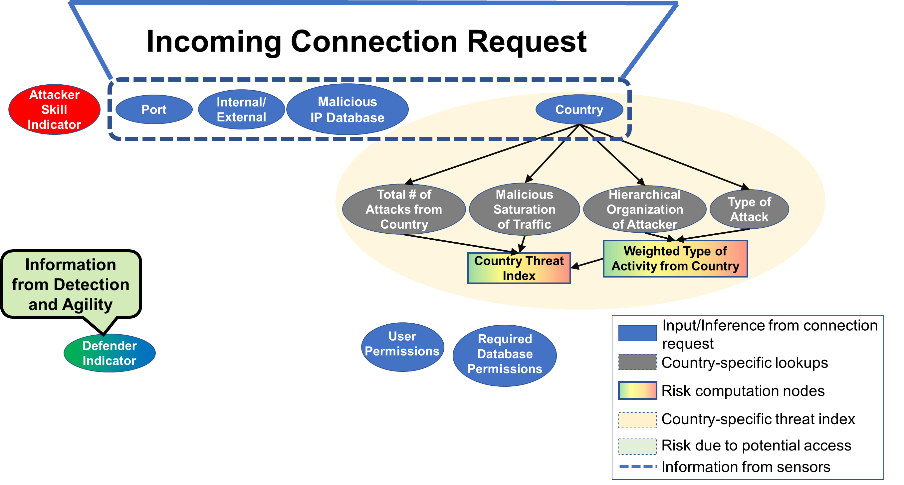
Step 3 – Include country-specific lookups

Slide 17
No. of attacks from country – Total logged attacks from a country in a year
Malicious Saturation of Traffic - % of traffic which is malicious
Notes:
Total # of attacks from country is the total number of logged attacks originating in a country in a timespan of a year,
Malicious saturation of traffic is the % of traffic which is identified to be malicious. It is used as a correction factor to number of attacks from country because it could be that the number of attacks from a country is higher but that could just be because there are way too many systems in that country.

Slide 18
Hierarchical Organization of Attacker – Individual, Independent group, State Tolerated, State Funded attackers
Notes:
Hierarchical Organization of Attacker measures the likelihood of an attacker being just an individual trying to get into the system,
or if the group of attackers are funded by the state,
or simply tolerated by the state.

Slide 19
Type of Attack – Captures risk associated with type of attack (Botnets – low risk, Phishing – Medium Risk, APT – High Risk)

Slide 20
Country Threat Index – Aggregates and measures risk due to country-specific metrics

Slide 21
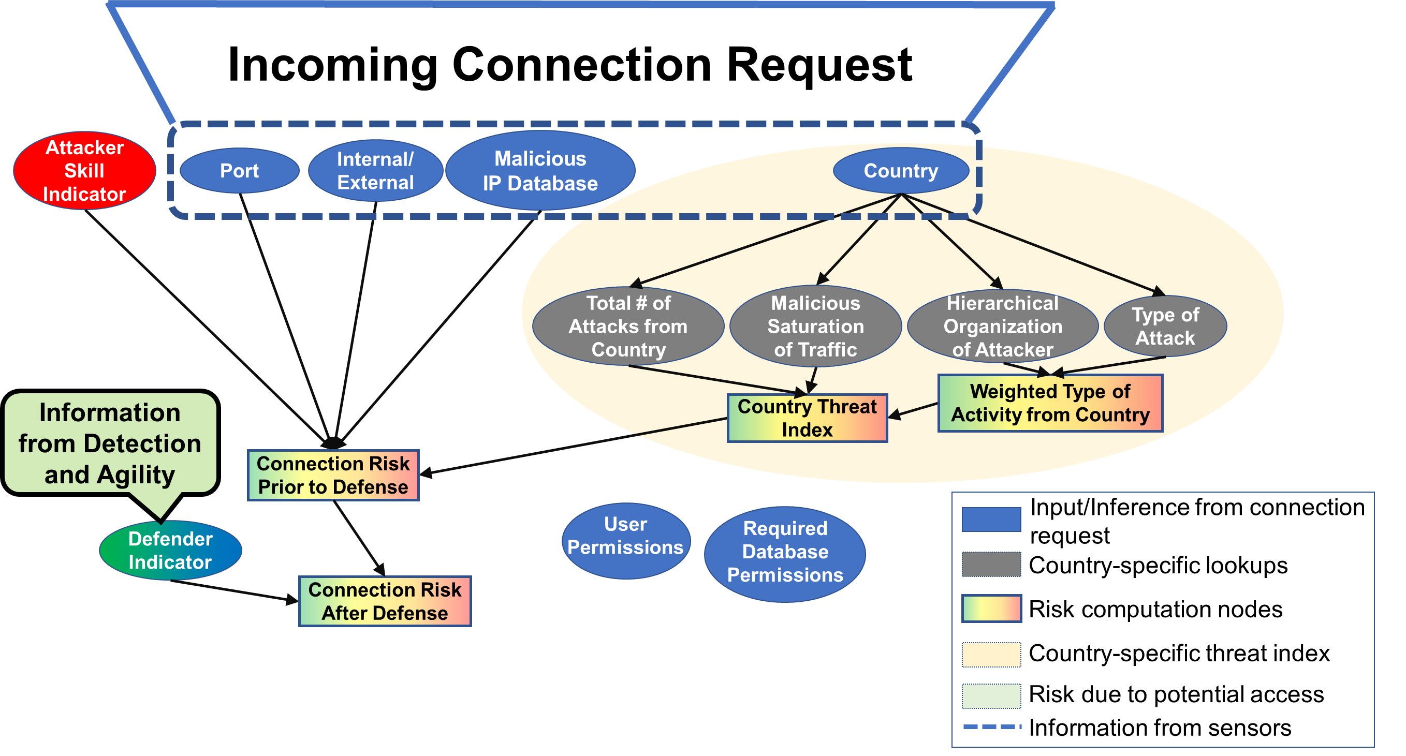
Connection Risk Prior to Defense – Aggregates risk from the connection metrics, before defender skill metric is accounted for
Notes:
Intermediate risk computation nodes help us in aggregating and explaining the risk due to independent and similar clusters of risk metrics.
In Bayesian sense, they also help identify high risk metrics in a cluster of risk metrics, by setting evidence.

Slide 22
Connection Risk After Defense – Aggregates risk after accounting for defender skill metric

Slide 23
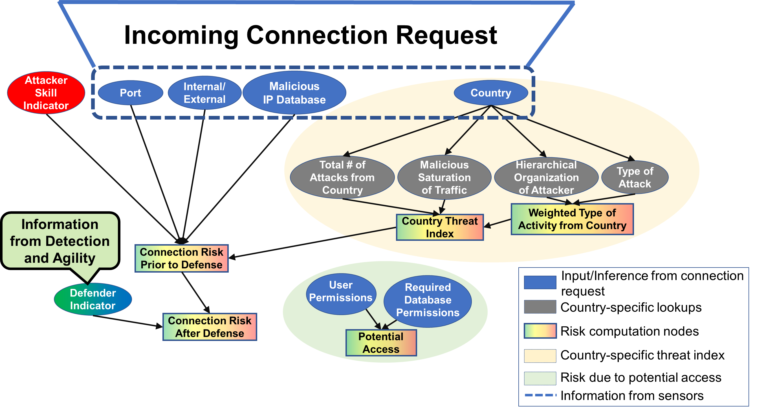
Potential Access – What is the potential that the query is successful?
Notes:
Potential Access node measures the risk associated with the potential of the query being successful.

Slide 24
Final Step – Aggregate risk due to all the accounted metrics in final risk node

Slide 25
Sources of Uncertainty
Skilled attackers can spoof IP address and appear to be on the internal network
First true origin of the connection request might be untraceable
Spoofing user permissions presents risk to the database
Specification bias in the model

Slide 26
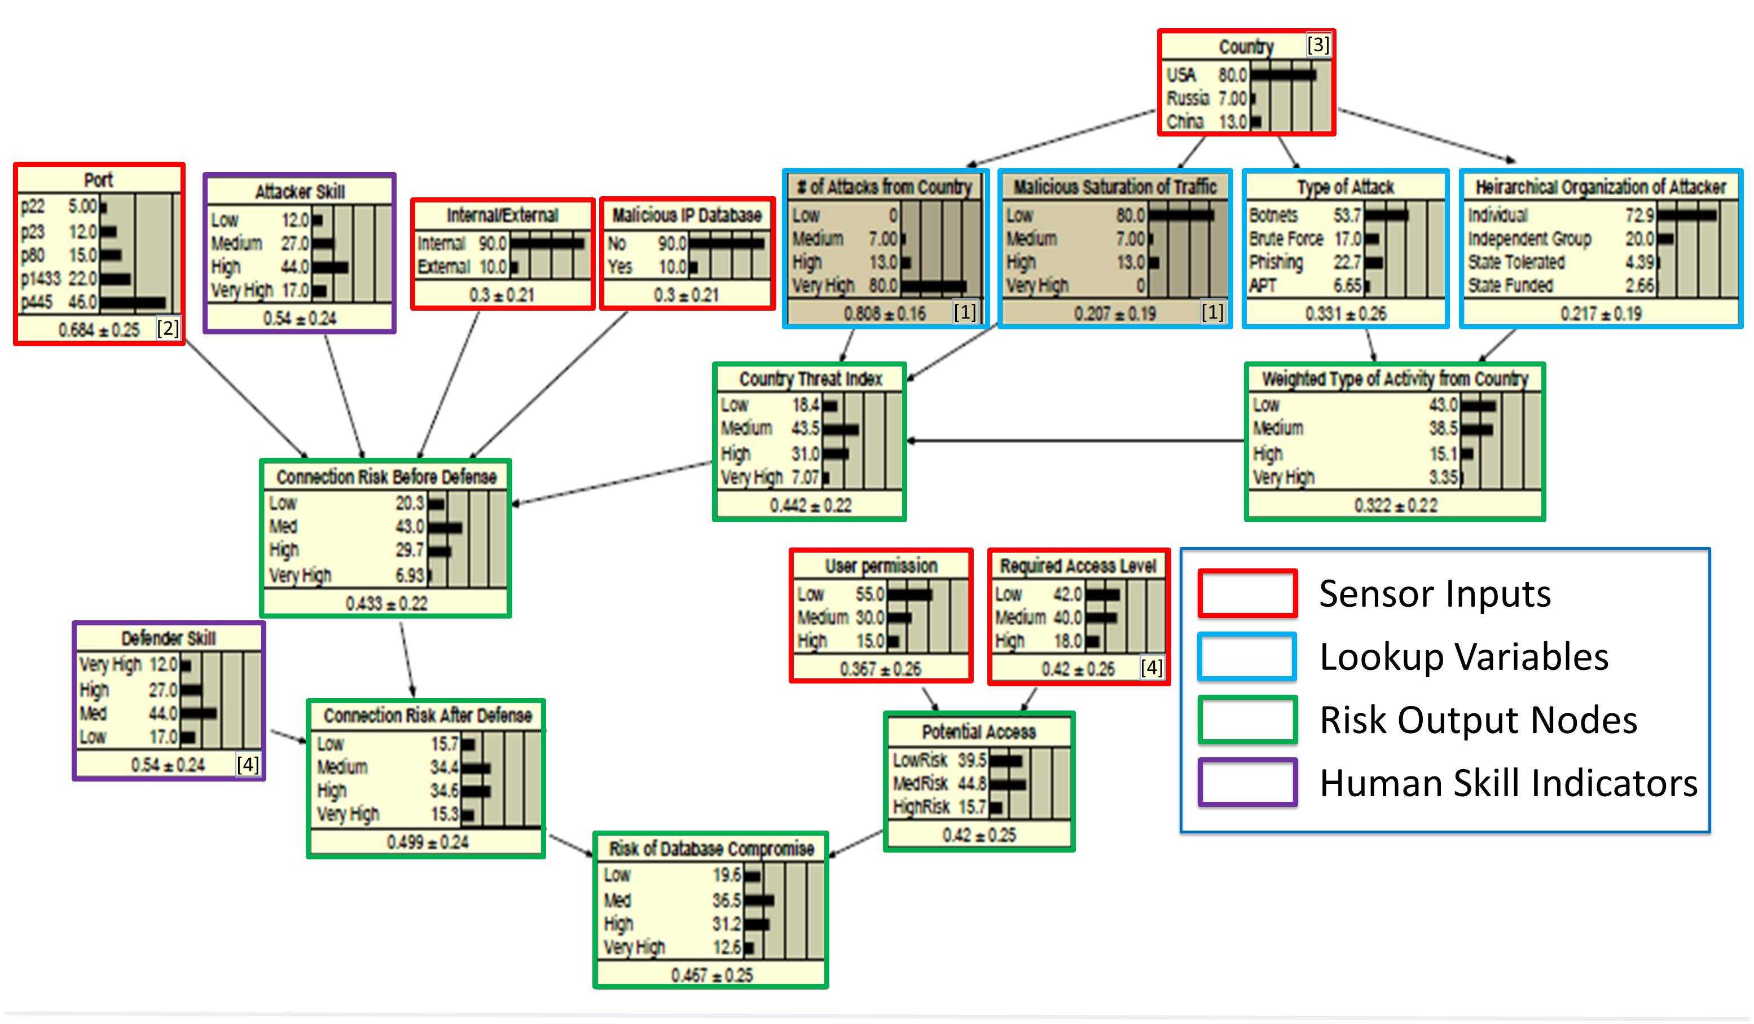
Statistical Application
Implemented conceptual framework as Bayesian Network
Directed edges represent dependencies
Figure shows marginal distribution for each node

Slide 27
Statistical Application
Priors for Sensor inputs inducted from cyber reports
Conditional probability tables hypothesized by collaborating with experts in risk and cybersecurity

Slide 28
Statistical Application
Risk to database calculated by conditional probability P(R|S)
S is the input state of the model – observed by setting evidence for sensor inputs and human skill indicators

Slide 29
Results
Variable | State S₁ | State S₂
Port (P) | p80 (Medium risk) | p445 (Very high risk)
Attacker Skill (AS) | Medium Skill (Medium to high risk) | Medium Skill (Medium to high risk)
Connection (C0) | Internal, (Low risk) | External, (High risk)
Malicious IP Database (IP) | Not listed, (Low risk) | Malicious Listed IP, (High risk)
Country Threat Index (CTI) | P(L| Country = USA) = 0.203 P(M| Country = USA) = 0.457 P(H| Country = USA) = 0.289 P(VH| Country = USA) = 0.051 | P(L| Country = China) = 0.061 P(M| Country = China) = 0.308 P(H| Country = China) = 0.445 P(VH| Country = China) = 0.185
Defense (D) | High Skill (Medium to low risk) | High Skill (Medium to low risk)
User Permission (UP) | Low, (Low risk) | High, (High risk)
Required Access Level (RAL) | Low, (Low risk) | High, (High risk)
Risk of Database Compromise (R) | P(L|S₁) = 0.383 P(M|S₁) = 0.376 P(H|S₁) = 0.161 P(VH|S₁) = 0.08 | P(L|S₂) = 0.098 P(M|S₂) = 0.215 P(H|S₂) = 0.508 P(VH|S₂) = 0.179
Evidence set for hypothetical scenarios
S₁ (Low – Medium Risk)
S₂ (High Risk)

Slide 30
Variable | State S₁ | State S₂
Port (P) | p80 (Medium risk) | p445 (Very high risk)
Attacker Skill (AS) | Medium Skill (Medium to high risk) | Medium Skill (Medium to high risk)
Connection (C0) | Internal, (Low risk) | External, (High risk)
Malicious IP Database (IP) | Not listed, (Low risk) | Malicious Listed IP, (High risk)
Country Threat Index (CTI) | P(L| Country = USA) = 0.203 P(M| Country = USA) = 0.457 P(H| Country = USA) = 0.289 P(VH| Country = USA) = 0.051 | P(L| Country = China) = 0.061 P(M| Country = China) = 0.308 P(H| Country = China) = 0.445 P(VH| Country = China) = 0.185
Defense (D) | High Skill (Medium to low risk) | High Skill (Medium to low risk)
User Permission (UP) | Low, (Low risk) | High, (High risk)
Required Access Level (RAL) | Low, (Low risk) | High, (High risk)
Risk of Database Compromise (R) | P(Low Risk|S₁) = 0.383 P(Medium Risk|S₁) = 0.376 P(High Risk|S₁) = 0.161 P(Very High|S₁) = 0.08 | P(Low Risk|S₂) = 0.098 P(Medium Risk|S₂) = 0.215 P(High Risk|S₂) = 0.508 P(Very High Risk|S₂) = 0.179

Slide 31

Conclusions and Future Tasks
Quantitatively integrated humans as risk factors in network risk calculations
Developed a metric to indicate relative risk by a country
Model provides a reasonable estimation of risk for different conditions of the network
Notes:
Model is only an abstraction of reality

Slide 32
Future Tasks
Validation of analysis
Validate against DETER testbed with modelled attackers and defenders
Assess model performance dynamically
Thank you!
varagarw@indiana.edu
Notes:
Model is only an abstraction of reality

